Slide 1
Solving Recurrence Relations
Complex roots

Slide 2
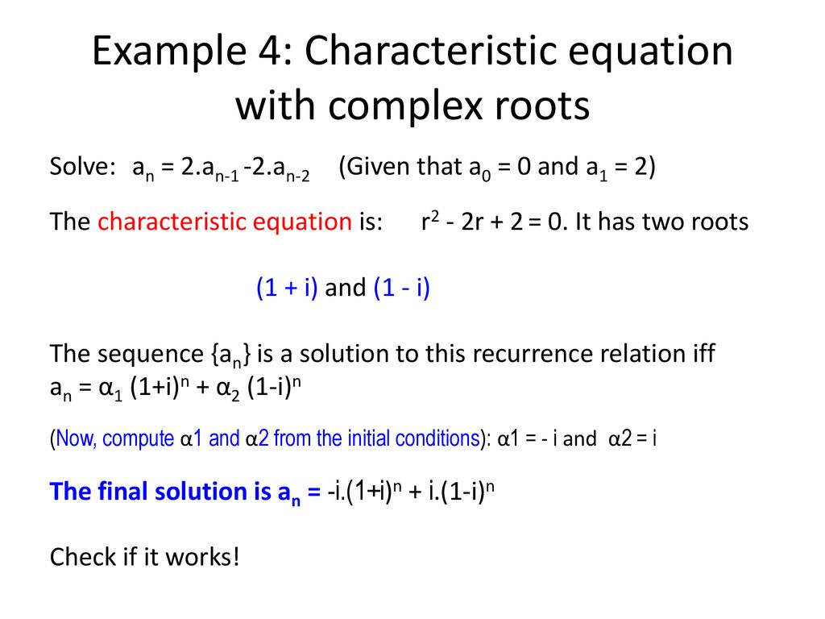

Slide 3
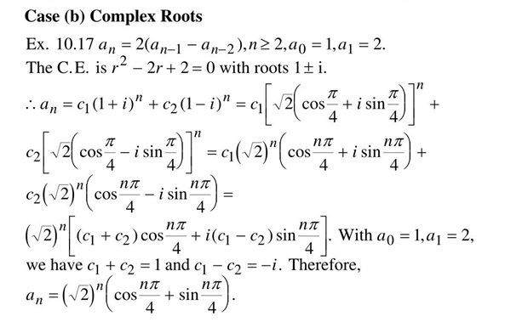

Slide 6
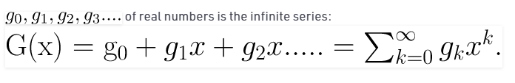

Generating Functions.
Generating functions are used to represent sequences efficiently by coding the terms of a sequence as coefficients of powers of a variable in a formal power series.
A generating function is a “formal” power series in the sense that we usually regard x as a placeholder rather than a number. Only in rare cases will we actually evaluate a generating function by letting x take a real number value, so we generally ignore the issue of convergence.

Slide 9
Recurrence Relations
Solving using generative functions

Slide 10
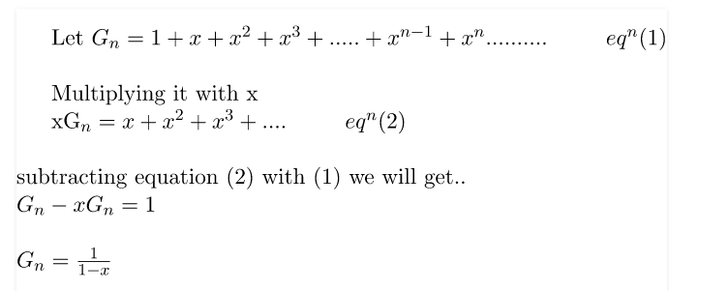
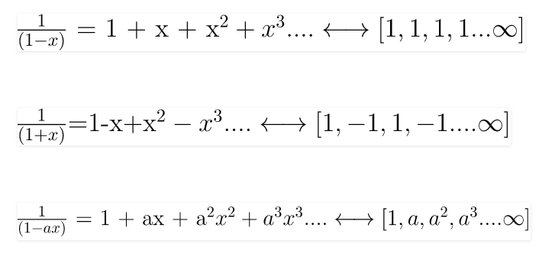


Slide 11
Generating Functions.
Def 1. The generating function for the sequence {a_{n}} is the infinite power series.
G(x) = a₀ + a₁x +… + a_{n}x^{n} +…
=

Slide 12
Example 2. What is the generating function for the sequence 1,1,1,1,1,1 ?
Sol :
(expansion)
(closed form)

Slide 13
Example 3.
Let m∈Z⁺ and ,for k = 0, 1, …, m.
What is the generating function for the sequence a₀, a₁,…, a_{m} ?
Sol :
G(x) = a₀ + a₁x + a₂x² + … + a_{m}x^{m}
= (1+x)^{m}

Slide 15
Example 5.
The function f (x) = is the generating
function of the sequence 1, a, a², …,
since = 1 + ax + a²x² + …=
when |ax| < 1 for a≠0

Slide 17
Def 2.
Let u∈R and k∈Z⁺∪{0}. Then the extended
binomial coefficient is defined by

Slide 18
Example 7.
Find and
Sol :

Slide 20
Thm 2. (The Extended Binomial Theorem)
Let x∈R with |x|<1 and let u∈R, then

Slide 21
Example 9.
Find the generating functions for (1+x)^{−n} and (1−x)^{−n} where n∈Z⁺
Sol : By the Extended Binomial Theorem,
Def 2.
By replacing x by –x we have

Slide 22
※Using Generating Functions to solve Recurrence Relations.
Example 16.
Solving the recurrence relation a_{k} = 3a_{k−1} for k=1,2,3,… and initial condition a₀ = 2.
Sol :
r – 3 = 0 ⇒ r = 3 ⇒ a_{n} = α ⋅ 3^{n}
∵ a₀ = 2 = α
∴ a_{n} = 2 ⋅ 3^{n}

Slide 23
Let be the
generating function for {a_{k}}.
First note that a_{k} x^{k} = 3a_{k−1} x^{k}
⇒
G(x) − a₀ = 3x ⋅ G(x)
∵a₀ = 2 ⇒ G(x) − 3x ⋅ G(x) = G(x)(1−3x) = 2
∴ a_{k} = 2 ⋅ 3^{k}

